Slide 1



Pulse Width Modulation
By Syed Arham and Tanu

Slide 2
Content for PWM
Introduction
Sampling Theorem
PWM
PTM
Interface

Slide 3


Sampling Theorem

Slide 4
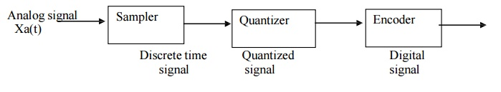
The Sampling Theorem, also known as the Nyquist-Shannon sampling theorem, is a fundamental concept in signal processing that defines the conditions under which a continuous-time signal can be accurately represented by a discrete-time signal. According to the theorem, a continuous-time signal can be perfectly reconstructed from its samples if the sampling rate is greater than twice the highest frequency component in the signal, known as the Nyquist rate. The Sampling Theorem is essential in digital signal processing and is used in applications such as audio and video recording and transmission.

Slide 5
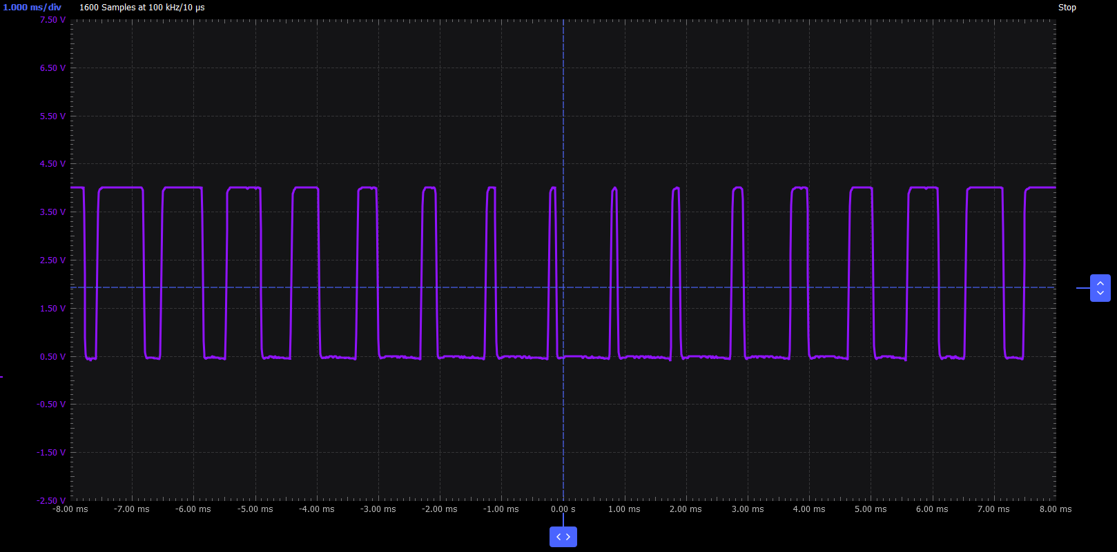
PWM
Pulse Width Modulation (PWM) is a technique used in electronics to encode information in a signal by varying the width of pulses. In PWM, the ratio of the pulse width to the total period is varied to encode information.

Slide 6
#include <QGuiApplication>
#include <QQmlApplicationEngine>
#include <QQmlContext>
#include <QQuickView>
#include "mymodel.h"
int main(int argc, char *argv[])
{
QGuiApplication app(argc, argv);
MyModel model;
QQmlApplicationEngine engine;
engine.rootContext()->setContextProperty("mymodel", &model);
const QUrl url(QStringLiteral("qrc:/ModelAbs/main.qml"));
QObject::connect(
&engine,
&QQmlApplicationEngine::objectCreated,
&app,
[url](QObject *obj, const QUrl &objUrl) {
if (!obj && url == objUrl)
QCoreApplication::exit(-1);
},
Qt::QueuedConnection);
engine.load(url);
return app.exec();
}

Slide 7
What is Message signal and Carrier signal
in signal modulation

Slide 8
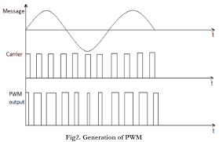
Message & Carrier Signal
In communication systems, a message signal is the signal that carries the information to be transmitted. On the other hand, a carrier signal is a high-frequency signal that is used to transmit the message signal.

Slide 9
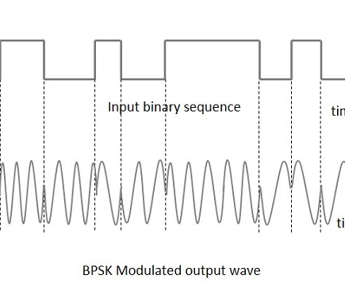
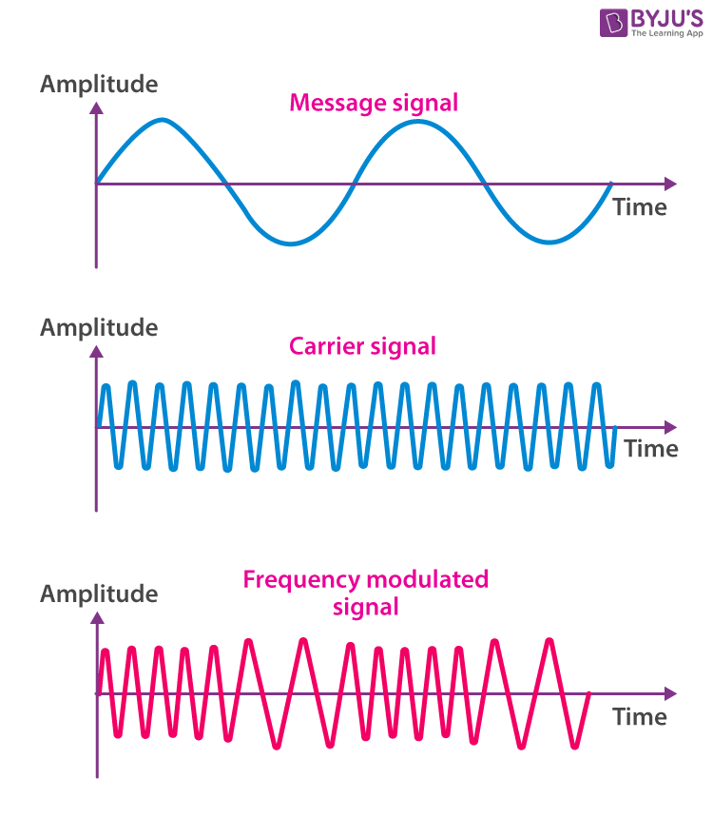
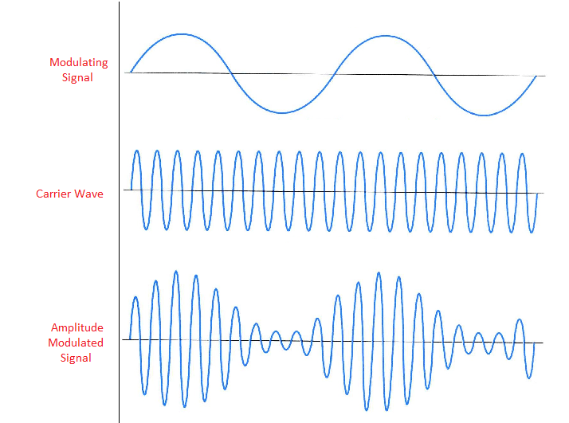
Types Of Modulation
Frequency Modulation
Phase Shifting Key
PFM
BPSK
Amplitude modulation
Width Modulation
PAM
PWM

Slide 10
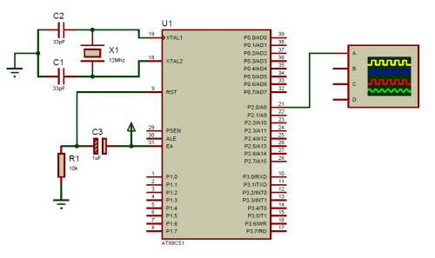
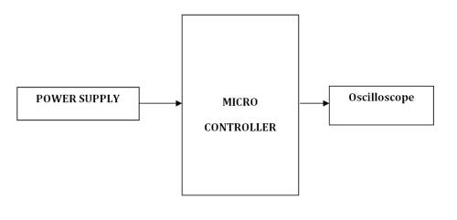
PWM in 8051

Slide 11
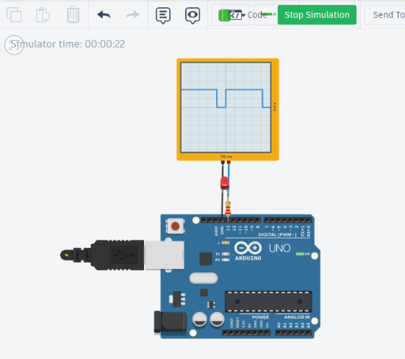

Slide 12
SECURING AUTOMOTIVE ECUs​
Increasing software and system complexity of vehicle platforms ​is causing higher probability of error​.
increased vulnerability and larger cyber attack surface​
Resulting in successful attacks on unsecured functions and applications​
​

Slide 13
To secure vehicles requires building blocks that complement each other.​
Secure individual ECU​
Secure E/E-architecture​
Secure in-vehicle network​
Secure connected vehicle​​

Slide 14
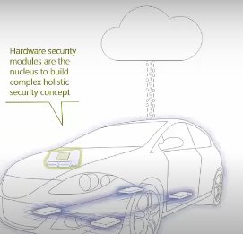
What is HSM?
Hardware security module (HSM) offers protection inside ECU’s main processor.

Slide 15
CycurHSM:
CycurHSM is an innovative and flexible HSM security firmware which enables Tier1s to fully comply with OEM security requirements by providing an easy to use plug and play solution
Features - Overview​
• Safety qualification (ISO 26262 ASIL-D)​
Modular structure​
• Preemptive real-time scheduling of crypto jobs​
• Full compatibility to AUTOSAR, SHE, and SHE+​
• Full support of HSM technology (Infineon, NXP, STMicroelectronics, Renesas)​
Security Mechanisms​:
• Cryptographic libraries (AES, RSA, ECC)​
• Key generation functionality (TRNG, PRNG)
​
• Key generation functionality (TRNG, PRNG)​
​
​
• Cryptographic libraries (AES, RSA, ECC)​
​
• Key generation functionality (TRNG, PRNG)​

Slide 16
What is GPIO?​ ​
A GPIO is a signal pin on an integrated circuit or board that can be used to perform digital input or output functions.​
Generally, GPIO can be used in multiple ways.​
GPIO Output Mode​
GPIO Input Mode​
Analog Mode​
Alternate function Mode​
​

Slide 17
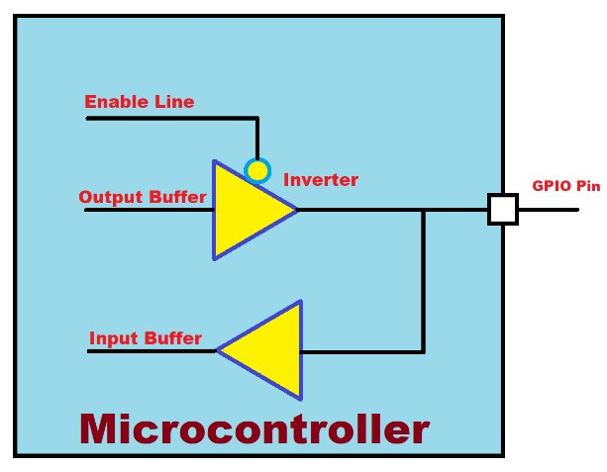
Let’s learn how the input and output mode works at the circuit level​
GPIO Block Diagram

Slide 18
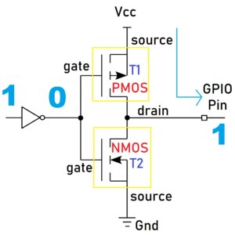
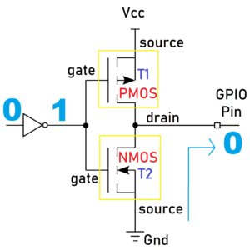
GPIO act as Output​
The output buffer is connected to the two CMOS Transistors. CMOS technology uses both N-type (NMOS) and P-type (PMOS) transistors.​
GPO HIGH
GPO LOW

Slide 19
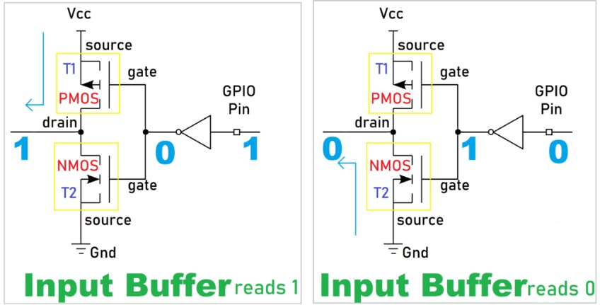
GPIO act as Input​
Input buffer High and Low

Slide 20
